Slide 1



Wind Power Generation Forecasting NAME: POTNURU DEEPTHIKA
ID : STU675bfd624a4721734081890

Slide 2

Learning Objectives
Predict Future Wind Energy Output Estimate power generation from wind turbines for upcoming hours, days, or weeks.
Enhance Grid Stability Provide accurate forecasts to maintain balance between electricity demand and supply.
Optimize Energy Storage Usage Help determine when to charge or discharge batteries based on expected wind power.
Support Power Trading & Market Operations Assist energy providers in planning and bidding efficiently in electricity markets.
Reduce Operational Costs Avoid unnecessary spinning reserves or backup generation through better planning.
Minimize Renewable Curtailment Improve the integration of wind energy into the grid, reducing wasted green power.
Improve Maintenance Scheduling Schedule turbine servicing during predicted low-wind periods to avoid energy loss.
Enable Smart Grid Operations Support intelligent decision-making in smart grids using real-time forecasting data.
Assist in Planning and Infrastructure Development Guide long-term investments in wind farms and transmission systems.
GOAL
Source :
www.freepik.com/

Slide 3
Tools and Technology used
Language used: Python
Environment : Jupyter notebook or Python IDLE
Dataset : https://www.kaggle.com/datasets/mubashirrahim/wind-power-generation-data-forecasting?select=Location2.csv other tools: scikit learn, NumPy , Pandas

Slide 4
Methodology
Data Collection
Gather historical wind speed, wind direction, temperature, and power output data.
Data Preprocessing
Handle missing values, remove outliers.
Normalize/scale features.
Convert time series data into supervised learning format (features vs. target).
Feature Engineering
Create relevant features such as lag values, rolling averages, wind power curves, etc.
Include temporal features (hour, day, season) and external weather data.
Model Selection
Choose appropriate models for forecasting:
Statistical Models: ARIMA, SARIMA
Machine Learning: Random Forest, XGBoost, SVR
Deep Learning: LSTM, GRU
Model Training and Validation
Split data into training and test sets.
Use cross-validation for reliable model performance assessment.
Tune hyperparameters using GridSearchCV or similar.
Forecasting and Evaluation
Predict wind power output using test data.
Evaluate performance using MAE, MSE, RMSE, and R² Score.
Data Collection
Gather historical wind speed, wind direction, temperature, and power output data.
Sources: Weather stations, wind turbines, meteorological APIs.
Data Preprocessing
Handle missing values, remove outliers.
Normalize/scale features.
Convert time series data into supervised learning format (features vs. target).
Feature Engineering
Create relevant features such as lag values, rolling averages, wind power curves, etc.
Include temporal features (hour, day, season) and external weather data.

Slide 5
Problem Statement:
Wind energy is a key renewable resource, but its intermittent and unpredictable nature makes it challenging to integrate into the power grid efficiently. Accurate forecasting of wind power generation is essential for: Grid stability Energy trading decisions Optimizing turbine operations Reducing reliance on fossil fuels
Objective : To develop a reliable forecasting model that can accurately predict future wind power generation using historical weather and turbine data, leveraging machine learning or statistical techniques.

Slide 6
Solution:
Data Collection Gather historical wind speed, temperature, humidity, and turbine output data from reliable sources.
Data Preprocessing Clean, normalize, and transform the raw data to make it suitable for modeling.
Feature Engineering Identify and create relevant features (e.g., wind speed squared, lag values) that influence power generation.
Model Selection Choose appropriate machine learning models such as: Linear Regression Random Forest XGBoostLSTM (for time series)Model Training & TestingTrain models using historical data and evaluate them using MAE, MSE, and R² Score.
Hyperparameter Tuning Use GridSearch CV or Randomized SearchCV to find the best model parameters.
Model Evaluation Compare model performances and select the most accurate one.
Forecasting Use the best-performing model to predict future wind power generation.
Visualization Present forecast results using graphs and dashboards for better interpretability.

Slide 7
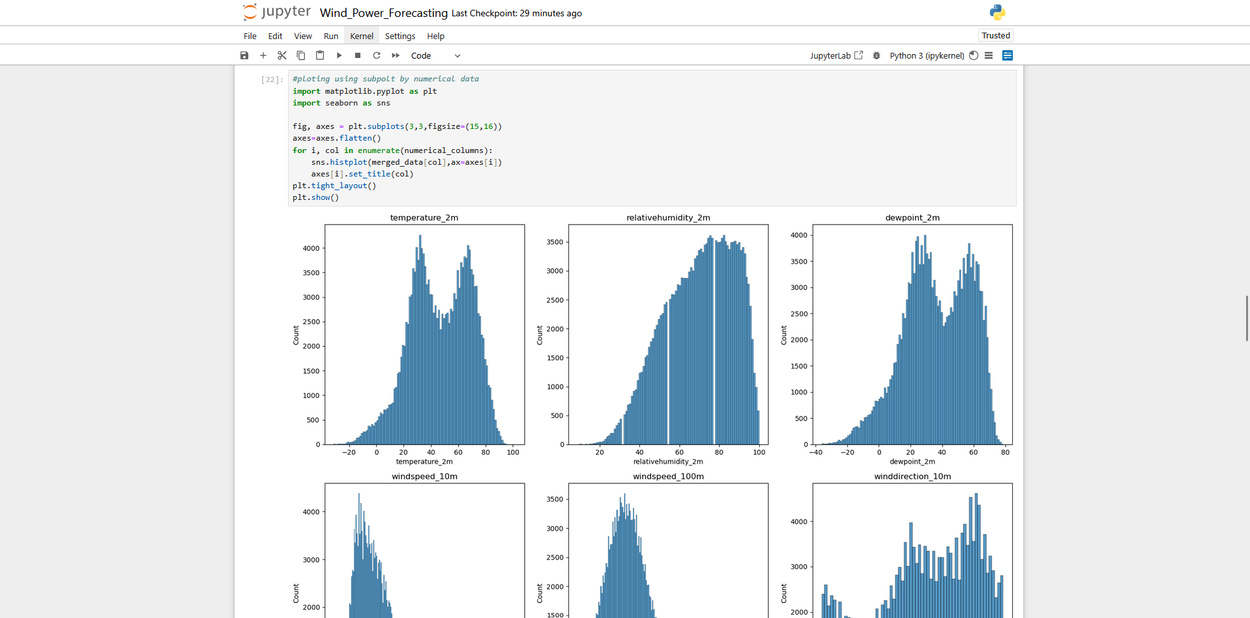
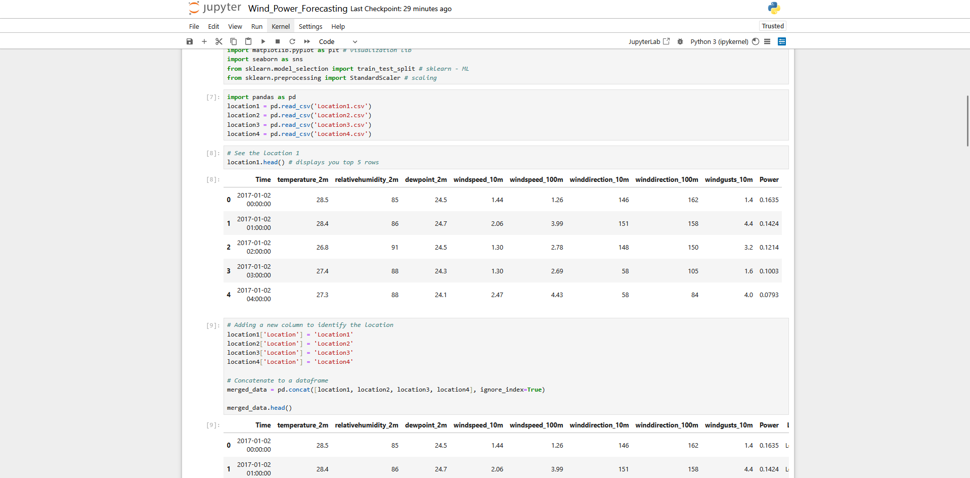
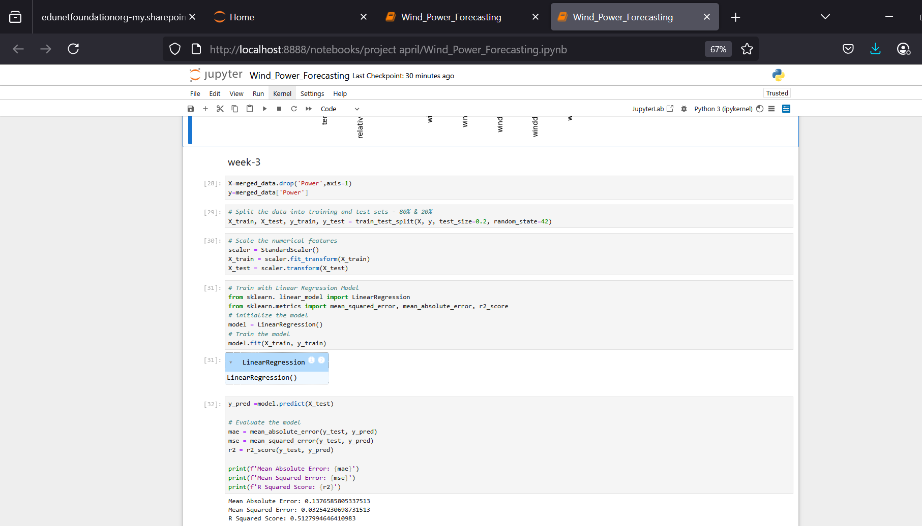
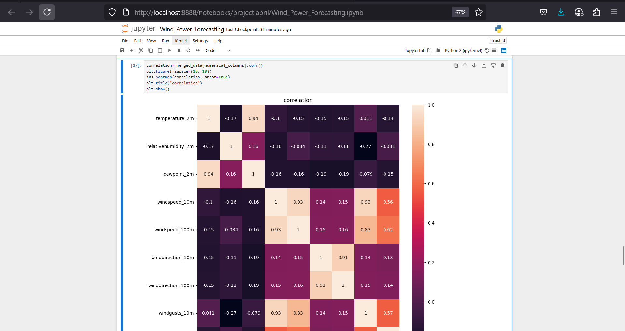
Screenshot of Output:

Slide 8
Conclusion:
The project has examined the complexities of the prognostication of wind power generation and the overarching problem of forecasting in the majority of renewable energy sources, using wind power as an exemplar. We have underscored the necessity of accurate forecasting procedures in getting the maximum or best energy output at the production to distribution levels. We have incorporated and examined forecasting models to illustrate how interaction between elements such as wind speed, temperature, and humidity leads to efficiency variances in the functionality of energy-producing wind turbines. Using machine learning methodologies with time series methods, we developed possible and approximate forecasts of wind power generation. The findings provided further supporting evidence of the potential models, including ARIMA and regression, being less accurate than combined models. We examined the implications of our findings in terms of grid stability and reducing wasted energy, both are elements for controlling and managing renewable energy resources in the future. To conclude, the impact of accurately forecasting the generation of wind power is pivotal in the integration of wind energy and existing power grids, ensuring sustainable energy resources, and assisting in the reduction of dependency on nonrenewable energy. Future work could elicit more complex deep learning models, as well as real-time data, as possible solutions improving forecast accuracy and introducing scalability applicable to predict wind power generation forecasts.
GitHub link: https://github.com/Deppu-2005/Wind-Power-Generation-Forecasting.git

